Slide 1
Pesticide hazard assessment:
In order to develop International food standards, guidelines, codes of practices and recommendation for food safety, FAO and WHO in 1963 established Codex Alimentarius Commission (CAC). As per CAC, Pesticide Hazard Assessment can be defined as a scientifically based process consisting of the hazard identification, hazard characterization, exposure assessment and risk characterization.
In most of the countries, it is prescribed through hazard assessment process for pesticides prior to their entrance to market and post marketing hazard assessment takes place during the use of pesticides and aims at assessing the risk of exposed operators.
EPA plays a critical role in evaluating these chemicals prior to registration, and in reevaluating older pesticides already on the market, to ensure that they can be used with a reasonable certainty of no harm.
1. Hazard Identification
The first step in the risk assessment process is to identify potential health effects that may occur from different types of pesticide exposure. EPA considers the full spectrum of a pesticide’s potential health effects.
Generally, for human health risk assessments, many toxicity studies are conducted on animals by pesticide companies in independent laboratories and evaluated for acceptability by EPA scientists. EPA evaluates pesticides for a wide range of adverse effects, from eye and skin irritation to cancer and birth defects in laboratory animals. EPA may also consult the public literature or other sources of supporting information on any aspect of the chemical.

Slide 2
Hazard characterisation
It involves considering the dose levels at which adverse effects were observed in test animals, and using these dose levels to calculate an equal dose in humans.
Exposure Assessment
People can be exposed to pesticides in following ways:
Inhaling pesticides (inhalation exposure),
Absorbing pesticides through the skin (dermal exposure), and
Getting pesticides in their mouth or digestive tract (oral exposure).
Depending on the situation, pesticides could enter the body by any one or all of these routes. Typical sources of pesticide exposure include:
Food Most of the foods we eat have been grown with the use of pesticides. Therefore, pesticide residues may be present inside or on the surfaces of these foods.
Home and Personal Use Pesticides You might use pesticides in and around your home to control insects, weeds, mold, mildew, bacteria, lawn and garden pests and to protect your pets from pests such as fleas. Pesticides may also be used as insect repellants which are directly applied to the skin or clothing.
Pesticides in Drinking Water Some pesticides that are applied to farmland or other land structures can make their way in small amounts to the ground water or surface water systems that feed drinking water supplies.
Worker Exposure to Pesticides Pesticide applicators, vegetable and fruit pickers and others who work around pesticides can be exposed due to the nature of their jobs. To address the unique risks workers face from occupational exposure, EPA evaluates occupational exposure through a separate program. All pesticides registered by EPA have been shown to be safe when used properly.

Slide 3
Risk Characterization
Risk characterization is the final step in assessing human health risks from pesticides. It is the process of combining the hazard identification, characterization and exposure assessments to describe the overall risk from a pesticide.
It explains the assumptions used in assessing exposure as well as the uncertainties that are built into the hazard characterization. The strength of the overall database is considered, and broad conclusions are made. EPA’s role is to evaluate both toxicity and exposure and to determine the risk associated with use of the pesticide.
Simply RISK = TOXICITY x EXPOSURE.
This means that the risk to human health from pesticide exposure depends on both the toxicity of the pesticide and the likelihood of people coming into contact with it. At least some exposure and some toxicity are required to result in a risk. For example, if the pesticide is very poisonous, but no people are exposed, there is no risk. Likewise, if there is ample exposure but the chemical is non-toxic, there is no risk. However, usually when pesticides are used, there is some toxicity and exposure, which results in a potential risk.
EPA recognizes that effects vary between animals of different species and from person to person. These uncertainty factors create an additional margin of safety for protecting people who may be exposed to the pesticides.

Slide 4
Pest survey and Surveillance
An insect pest survey is a detailed collection of insect population information at a particular time in a given area.
The regular survey of same place or locality at consistent intervals to assess changes in pest species over a time is called surveillance. It includes identification of pest, determining the stage and population density of pest and natural enemies, estimating loss the pest may cause, the economic and other benefits that pest control will provide.
Pest survey can be grouped into:
1. Qualitative survey- Pest detection, provides list of pest species. Done for newly introduced pest and their extent of infestation.
2. Quantitative survey- abundance of pest population in time and space.
Components of pest surveillance
1. Identification of pest: expert should be involved who knows all stages and morphological characters. The pests are collected and reared and consulted with taxonomist or other expert.
2. Determination of Pest population: pest population are known by two ways:
Detection sampling- though the pest is not seen at present condition, past pest population sampling is taken and with the help of predictive models, present insect population forecasting is done.
Estimation sampling- the present population is taken from sampling unit and the total population is calculated by using predictive models and forecasting it.

Slide 5
3. Estimation of abundance of natural enemies:
In any sampling unit number of natural enemies are counted with their different life stages and the population is predicted.
4. Estimation of yield loss:
The degree of damage or average defoliation is found out and actual yield is recorded. The correlation between crop yield and degree of damage of infestation is worked out to estimate the loss in yield.
Field monitoring for insect pests
Correct identification of immature and adult stage of both pests and beneficial and accurate assessment of their presence in field at various crop stages will ensure appropriate and timely management decisions.
Factors that contribute to quality monitoring:
1. Knowledge of likely pests/ beneficial and their life cycles.
2. Monitoring frequency and pest focus.
3. Sampling technique, random sampling, stratified sampling, systematic sampling

Slide 6
Types of monitoring:
1. Absolute methods:
pest population density are expressed as a level per unit crop area or as percentage of the sampling units affected. Eg: direct visual counts/plant or per foot of row or per unit area.
2. Relative methods:
Estimates of pest population per unit of effect or time, not expressed per unit area. Eg: visual searches with sweep net, pheromone traps, etc.
4. Population indices:
Estimates of crop damage or the frequency of pest infestations which indirectly reflect the size of pest population. Eg: percentage of plants infested or diseased, percentage of defoliation, etc.
Sampling methods
Exploring insect pest in the crop field to identify them, their abundance, and their extent of damage in the field is included under sampling methods.
Sampling methods are carried out by following ways:
1. Using beat sheet
A beat sheet is the main tool used to sample row crops for pests and beneficial insects. They are effective for sampling caterpillars, bugs, aphids and mites. The measurement of beat sheet should be 1.5m wide and 2 m length. Beat sheet should be used if row to row distance is greater than 30 inches. Standard beat sheet is made from yellow or white waterproof material with support at each ends.

Slide 7
How to use beat sheet?
Place the beat sheet with an edge at the base of plants in the rows to be sampled. Use 1 m long stick to shake the plants in the direction towards beat sheet for 5-10 times that will make insects to fall there. Take 3 samples for every 3 acres. If no insects are found after 3 samples, no further sampling is necessary. Collect the insects and identify them.
2. Visual checking:
In the small area of field like that of kitchen garden, it is easier to find out the caterpillars and bugs, their eggs and count them.
3. Sweep net sampling:
The row to row distance less than 30 inches is sampled with the help of sweep net. About 20 sweeps are made in the field for the sampling of insects like bugs, caterpillars and other flying insects.
4. Traps:
Different types of traps are available such as light trap, pheromone trap, yellow sticky pan trap, etc. that helps to collect insects and thus identifies the pest population status of that surrounding field.
5. Suction sampling
Such type of sampling is done by aspirators for small insects and storage insect pests.

Slide 8
Use of novel technique in pest management: The use of novel approaches aimed at modifying, managing and regulating insect pests rather than killing them.
1. Entomopathogens
Entomopathogens are composed of microscopic living organisms (viruses, bacteria, fungi, protozoa, or nematodes) or the toxins produced by these organisms, are formulated to be applied as conventional insecticidal sprays, dusts, or granules.
1. Fungi 2. Bacteria 3. Nematode 4. Virus 5. Protozoa
2. Biological control: Biological control comprises three general approaches viz., importation, augmentation, and conservation of natural enemies.
3. Botanical Insecticides
These insecticides are relatively safe for natural enemies and higher organisms. One of the potentially used and safer components in integrated pest management (IPM) is the use of neem and its derivative, ‘Azadirachtin’.
Azadirachtin is most popular and commercially available as different types of ready to use formulations.
Neem (Azadirachta indica) derived products seem to be safe for the environment and IPM compatible.
Some of the other promising plant species that are known to have pest control properties are: sweet flag,onion, garlic, pyrethrum, derris, common lantana, holy basil, black pepper, and common ginger. Biopesticides with rapid degradation are beneficial because it minimizes the risks due to unwanted insecticidal residues in food, water, and the environment.

Slide 9
4. Biotechnology and genetically modified organisms:
Genetically modified crops (GMCs, GM crops) are plants used in agriculture. They contain modified DNA by using genetic engineering techniques. Examples of food crops include resistance to certain pests, diseases, or environmental conditions, reduction of spoilage, or resistance to herbicide, or enriched nutrient profile crop.
5. Insect attractants/Semiochemicals/Repellants/Antifeedants/Hormones: are those chemicals that have power of bringing positive response by insects through olfactory stimulation which orient them to the source of food, host plants or opposite sexes.
Semiochemicals are the chemical substance that deliver behavioral message. These include kairomones (benefits the reciever), allomones (that benefits the producer), pheromones including classes of other wide range of behaviorally active compounds
Substances that prevent damage by making food or living condition unattractive for the pests is known as repellants.
Antifeedants are those chemicals which inhibit feeding when applied or present in plants and in its absence insect would feed. Eg: triazenes, organotins,etc.
Hormones: are internal secretions that regulate a wide range of physiological processes including growth, development and maturation.

Slide 10
National and International treaty, conventions and organizations related to pesticides:
In 1962, Rachel Carson published a book, Silent Spring, in which the adverse effect of pesticides in the environment was documented. In 1963, WHO and FAO established Codex Alimentarius Commission (CAC) to develop International food standards, guidelines, codes of practices and recommendation for food safety. CAC developed Pesticide Hazard Assessment that defines the process as hazard identification, hazard characterization, exposure assessment and risk characterization.
PAN (Pesticide Action Network)
It is a network of over 600 participating NGOs, institutions and individuals to replace the use of hazardous pesticides with ecologically sound alternatives. PAN was founded in 1982, has five independent collaborating regional centers. Recalling the incident occurred in Bhopal, India in 1984, PAN marked December 3rd, as ‘No Pesticide Use Day’ every year.
OECD (Organisation for Economic Cooperative and Development)
The Convention transforming the OEEC into the OECD was signed at the Chateau de la Muette in Paris on 14 December 1960 and entered into force on 30 September 1961. Through its Environment Program, OECD helps countries to manage data and methods used to test and assess pesticide risks, share the work of pesticide registration and re-evaluation and help government reduce the risk associated with pesticide use.
In 1994, Pesticide Forum, now called Working group on pesticides help countries to cope with the increasingly burdensome workload of conducting new risk assessments for hundreds of pesticides.
AGP (Plant Production and Protection Division)
Under FAO, AGP considers reduced reliance on pesticides as a principle element of its focus on sustainable production intensification and pesticide risk reduction.
WHOPES (WHO Pesticides Evaluation Schemes) deals with the pesticide residue and food safety.

Slide 11
International convention related to pesticide:
Rotterdam Convention
Jointly introduced by the Governing Council of the United Nations Environment Programme (UNEP)and the Food and Agriculture Organization of the United Nations (FAO) Council, the Rotterdam Convention was done on the Prior Informed Consent Procedure for Certain Hazardous Chemicals and Pesticides in International Trade (the Rotterdam Convention).
The Rotterdam Convention is an international treaty designed to facilitate informed decision-making by countries with regard to trade in hazardous chemicals. It establishes a list of covered chemicals and requires parties seeking to export a chemical on that list to first establish that the intended importing country has consented to the import. It also requires that a party seeking to export a chemical that is not listed under the Convention but that is subject to a ban or severe restriction in its own territory must provide notice to the importing country of the proposed export. The treaty was signed on 10 September 1998 and the Convention entered into force on February 24, 2004. in Rotterdam, Netherlands

Slide 12
Stockholm Convention
Stockholm Convention on Persistent Organic Pollutants is an international environmental treaty, signed on 22 May 2001 in Stockholm, Sweden and effective from 17 May 2004, that aims to eliminate or restrict the production and use of persistent organic pollutants (POPs).
Persistent Organic Pollutants (POPs) are chemicals that resist degradation, capable of traveling long distances, bioaccumulate in the food chain, thus posing harmful effects to human health and the environment. Introduced by the Governing Council of the United Nations Environment Programme (UNEP), the Stockholm Convention on Persistent Organic Pollutants (the Stockholm Convention) aims to protect human health and the environment from POPs by eliminating or reducing the release of POPs, which encompass pesticides, industrial chemicals and by-products, into the environment.
The twelve initial POPs listed under the Stockholm Convention, are aldrin, chlordane, DDT, dieldrin, endrin, heptachlor, hexachlorobenzene(HCB), mirex, toxaphene, polychlorinated biphenyls (PCB), polychlorinated dibenzo-p-dioxins(PCDD) and polychlorinated dibenzofurans (PCDF)

Slide 13
Basel Convention:
The convention was opened for signature on 21 March 1989, and entered into force on 5 May 1992 in Basel Switzerland.
The Basel Convention on the Control of Transboundary Movements of Hazardous Wastes and Their Disposal, usually known as the Basel Convention, is an international treaty that was designed to reduce the movements of hazardous waste between nations, and specifically to prevent transfer of hazardous waste from developed to less developed countries (LDCs). It does not, however, address the movement of radioactive waste. The convention is also intended to minimize the rate and toxicity of wastes generated, to ensure their environmentally sound management as closely as possible to the source of generation, and to assist LDCs in environmentally sound management of the hazardous and other wastes they generate.

Slide 14
Status of Pesticide Use in Nepal:
The main promoters of pesticide in Nepal are:  Cotton Development Committee  Agricultural Inputs Corporation,  Government Agriculture farm and Research Stations,  District Agriculture Development Offices  And Frontline Extension Workers.
PAN (Pesticide Association of Nepal) is an umbrella organization established in 1977 to integrate Nepali firms, companies and individual related to pesticides.
Nepal has been emphasizing the IPM from the beginning to date with the technical and financial support of FAO and some outputs are as follows:  Technical Cooperation Project (FAO/TCP): 1997-1999  Community IPM program : 2000  National IPM Program –Phase I : 2003 - 2007  National IPM Program –Phase II: 2008- 2013
Act and regulation related to pest management in nepal: Plant Protection Act, 2007 Plant Protection Rules, 2010 Pesticides Act, 2048 Pesticides Rules, 2050 Seed Act, 2045, Pesticide Management Act 2019,

Slide 15
Plant Quarantine and Pesticide Management Center, under the Ministry of Agriculture and Livestock Development has been established in 2018 to regulate the potential risk on plant health arising from the international trade of the plants and plant products and to regulate the import, distribution, use and management of pesticides used for the management of the plant pests on different plants and plant products on the field and their post-harvest stage.
Government of Nepal has established Plant Quarantine and Pesticide Management Center at the central level under which there are 15 quarantine offices.
Kakadvitta, Jhapa  Birgunj, Parsa
Bhairahawa, Rupandehi  Nepalgunj, Banke
Gaddachauki, Kanchanpur  Biratnagar, Morang
Bhantabari, Sunsari  Jaleshwor, Mahottari
Malangwa, Sarlahi  Krishnanagar, Kapilvastu
Timure, Rasuwa  Tatopani, Sindhupalchock
Tribhuvan International Airport, Kathmandu
Lomanthang, Mustang  Jhulaghat, Baitadi

Slide 16
There are 5 sections in the Plant Quarantine and Pesticide Management Center. They are:
National Plant Protection Organization Section
Plant Quarantine Regulation and Monitoring Section
Pesticide Registration and Management Section
Pest Risk Analysis Section
Survey and Surveillance Section

Slide 17
Registered Pesticides in Nepal (upto 2022-07-31)
S.NO | Pesticide category | Trade Name | Common name
1. | Insecticide | 1788 | 56
2. | Fungicide | 1141 | 42
3. | Herbicide | 620 | 30
4. | Bactericide | 24 | 1
5. | Rodenticide | 41 | 2
6. | Molluscicide | 4 | 1
7. | Nematicide | 1 | 1
8. | Bio-pesticide | 171 | 14
9. | Herbal products | 17 | 13
10 | Miticide | 32 | 5
Source: http://www.npponepal.gov.np/downloadfile/Book%20Data%20Book_1666887367.pdf

Slide 18
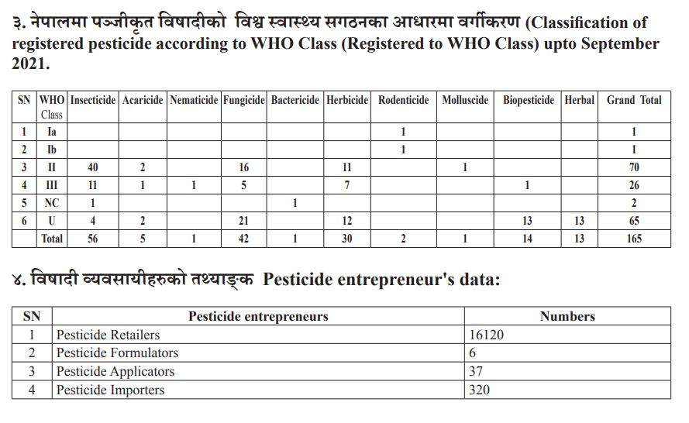

Slide 19
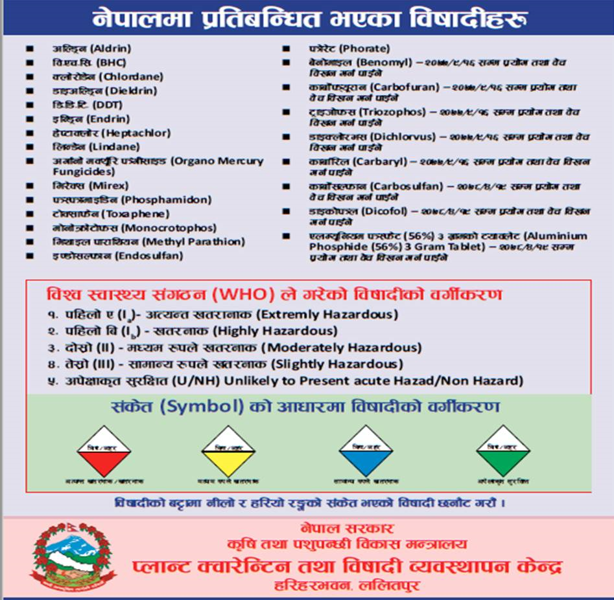

Slide 20
The total amount of pesticides used is 396 gm a.i./ha.

Slide 21
Maximum Residue Limits (MRLs) are defined as the maximum concentration of pesticide residue (expressed as mg of residue per kg of food/animal feeding stuff, mg/kg) likely to occur in or on food as a result of the use of pesticides according to good agricultural practice (GAP) and product label recommendation.
The maximum residue limit (also maximum residue level, MRL), is the maximum amount of pesticide residue that is expected to remain on food products when a pesticide is used according to label directions, that will not be a concern to human health
In Nepal, The Department of Food Technology and Quality Control (DFTQC) regulate MRLs of pesticides.
In the absence of an established MRL, the DFTQC generally refer to FAO/WHO’s CAC (Codex alimentarius commission) MRLs.
The Codex MRLs serve as the reference standards in international trade, but many industrialized countries use their own set of MRLs for import and domestic food products.
The EU MRLs are generally lower than USA MRLs, and often lower than Codex MRLs.

Slide 22
Residue level measurement: (RBPR: Rapid Bioassay Pesticide Residue)
RBPR technology was first developed by Taiwan Agriculture Research Institute (TARI) in 1958 to check the residue of organophosphate and carbamates groups of pesticides and fungicides residue level through enzymatic reaction.
In Nepal, RBPR technology was established in Kalimati on 18 June 2014 under the of Plant Protection Directorate.
Chemical used in this technology is AchE ( Acetyl cholinesterase ) Isolated from the brain of House fly.
When AchE solution is mixed with samples from healthy produce, it slowly turns yellow. If insecticides is present the enzymatic reaction slows down or stops.
The rate at which color development is inhibited indicates the quality of chemicals present , as well as their toxicity.
The AchE test is very rapid, taking only 15 minutes from sampling to completion.

Slide 23
The B.t. test uses Bacillus thuringiensis to detect fungicide residue.
B. thuringiensis is a bacterium which is entomopathogenic. i.e. it causes disease only in insects and is highly sensitive to some fungicides used on vegetables.
Vegetable samples are finely chopped and placed in EDTA (Ethylene Diamine Tetra Acetic Acid) solution for 5 minutes. The extract is incubated with a suspension of B. thuringiensis for 90 minutes (the period of four generations of bacteria). Then TTC (Triphenyl tetrazolium chloride) solution is added and left to act for another 30 minutes. Finally, the reaction is halted with Triton- HCl mixture, which acts as a red color signal for B. thuringiensis activity.
If fungicide residues are present, there is no metabolic activity by the bacteria and no red color. If by the end of the test period the mixture has not turned red but still its original pale yellow, it probably contains toxic chemical residues.

Slide 24
Garlic and ginger can kill bacteria naturally, and can't be tested by B.t. Some compounds which occur naturally in oranges and tea also interfere with the TTC reaction. Strawberry fruits contain a red pigment, which makes it difficult to distinguish any color change from bacteria. It is possible to test these two groups, but the procedure must be modified.
The result withdrawn from the inhibition percentage given by AchE test:
Below 35 % : edible
35- 45 % : Need quarantine for few days
More than 45% : not edible (red)
The inhibition % is calculated through spectrophotometer. The increasing absorbance for sample at 412 nm is recorded, compared to the insecticide free blank( normal) AchE reaction and the inhibition % is calculated.
% inhibition= Absorbance change (normal) - Absorbance change (sample) *100
Absorbance change (normal)

Slide 25
AchE is obtained from the heads of housefly. They are reared in isolation for more than 3 decades and never exposed to chemicals. These flies are then frozen and placed to dry ice and shaken so that the heads drop off. After the enzyme is extracted from the heads, it is freeze dried into stable dry powder which is stored indefinitely.
In AchE test, sample vegetable leaves or peel of fruits or vegetables are taken from 4 different plants and are chopped into fine pieces. Now these pieces are transferred into test tube with 1 ml ethanol and subjected to vibrate on test tube mixer for 30 secs and soaked for another 2.5 mins for extraction. Test tubes are covered by paraflim and then drained to get the sample extract.
Now in 1cm glass cuvette, add 3 ml PBS (Phosphate buffer solution with pH 8.0), 20 microliter AchE solution and 20 microliter sample extract. After mixing and standing for 3 minutes, add 0.1 ml DTNB (5,5’-dithio-bis(2-nitrobenzoic acid) solution and 20 microliter of ATCI (Acetylthiocholine iodine) solution to start the reaction and after few seconds subject it into spectrophotometer.
In the sample after reaction, if the solution is yellow, the sample vegetables or fruits are healthy as AchE reaction increases 5-thio-2-nitrobenzoateanion. If insecticide is present, the reaction stops. The time takes only 15 minutes.
The AchE test doesn’t give false positive results. That means it doesn't indicate the presence of insecticides when they are not. However it does sometimes give a false negative. It can't detect certain insecticides, for example, synthetic pyrethroids, and gives a negative result even if they are present.

Slide 26
Sanitary and phytosanitary measures
Sanitary and phytosanitory is basically the Agreement on the Application of Sanitary and Phytosanitary Measures, also known as the SPS Agreement, is an international treaty of the World Trade Organization.
Under the SPS agreement, the WTO sets constraints on member-states' policies relating to food safety (bacterial contaminants, pesticides, inspection and labelling) as well as animal and plant health (phytosanitation) with respect to imported pests and diseases.
SPS measures include import restrictions or maximum residue levels. The agreement says governments’ SPS measures should be based on:
recognized international standards, particularly those of the “three sisters” — FAO/WHO Codex Alimentarius Commission, the World Organization for Animal Health (OIE), the International Plant Protection Convention (IPPC)
science, including scientific assessment of risk
a temporary precautionary principle in the absence of international standards or scientific evidence

Slide 27
Sanitary and phytosanitary measures deal with food safety and animal and plant health.
They aim to ensure that a country’s consumers are being supplied with food that is safe to eat — by acceptable standards — while also ensuring that strict health and safety regulations are not being used as an excuse to shield domestic producers from competition.
International Standards for Phytosanitary Measures are prepared by the Secretariat of the International Plant Protection Convention as part of the United Nations Food and Agriculture Organization’s global programme of policy and technical assistance in plant quarantine.

